Slide 1


https://cellml.org
David Nickerson et al
Auckland Bioengineering Institute
University of Auckland
New Zealand

Slide 2

https://cellml.org/
Modular framework for encoding mathematical models:
focus on encoding models consisting of differential algebraic equations using MathML
math is the primary data, biological context, provenance, etc., provided through annotations using RDF
All quantities require physical units ensuring unambiguous conversion of numerical values where required
CellML models able to define hierarchies of modules to enable mathematical abstraction
Hierarchical modules able to be imported from external CellML models enabling reuse
Current version: 1.1
Latest version: 2.0 (draft)

Slide 3
libCellML
Key resources
https://github.com/cellml/libcellml
CellML 2.0 only
replacement of the CellML API
aims to become an easy to use library that will be useful to developers of CellML applications
well documented and tested
Current state
“full” data model for CellML 2.0
C++ implementation, Python bindings available
validation
working on code generation

Slide 4
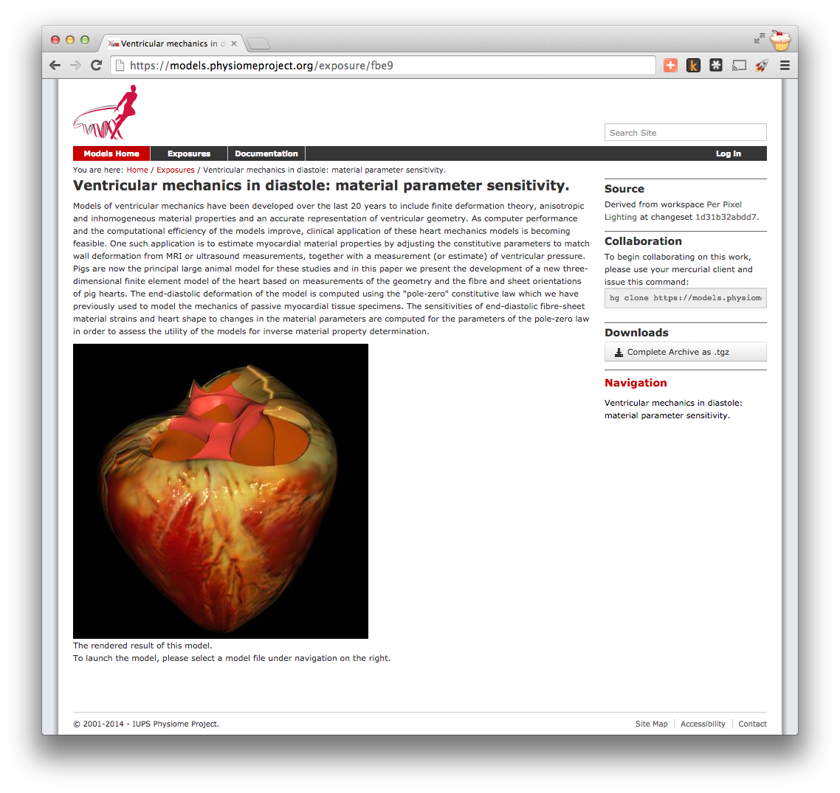
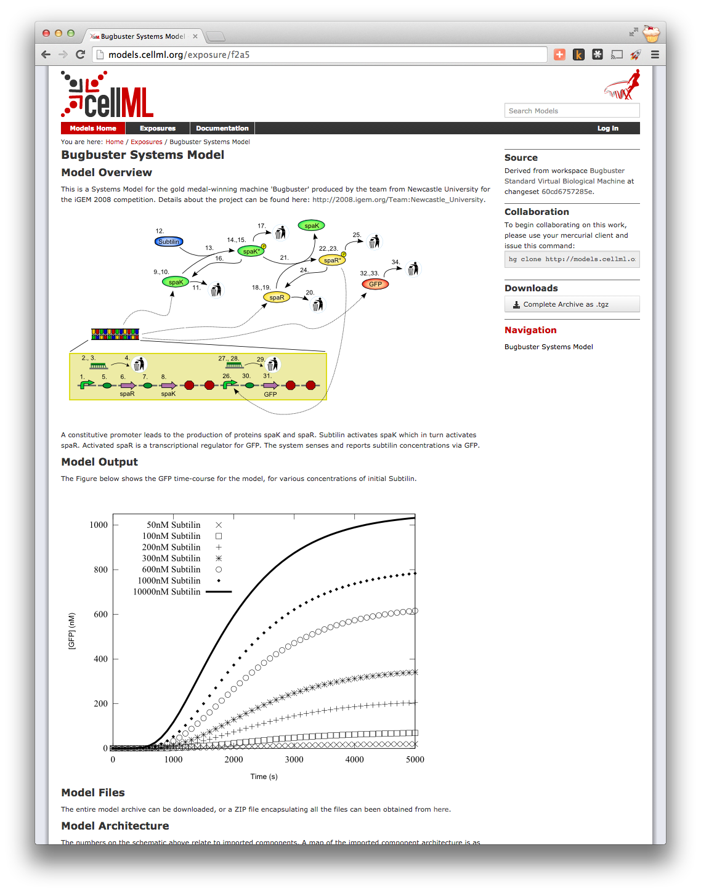
Physiome Model Repository
Key resources
https://models.physiomeproject.org
free and open repository supporting versioned model reuse, archiving, collaboration…

Slide 5
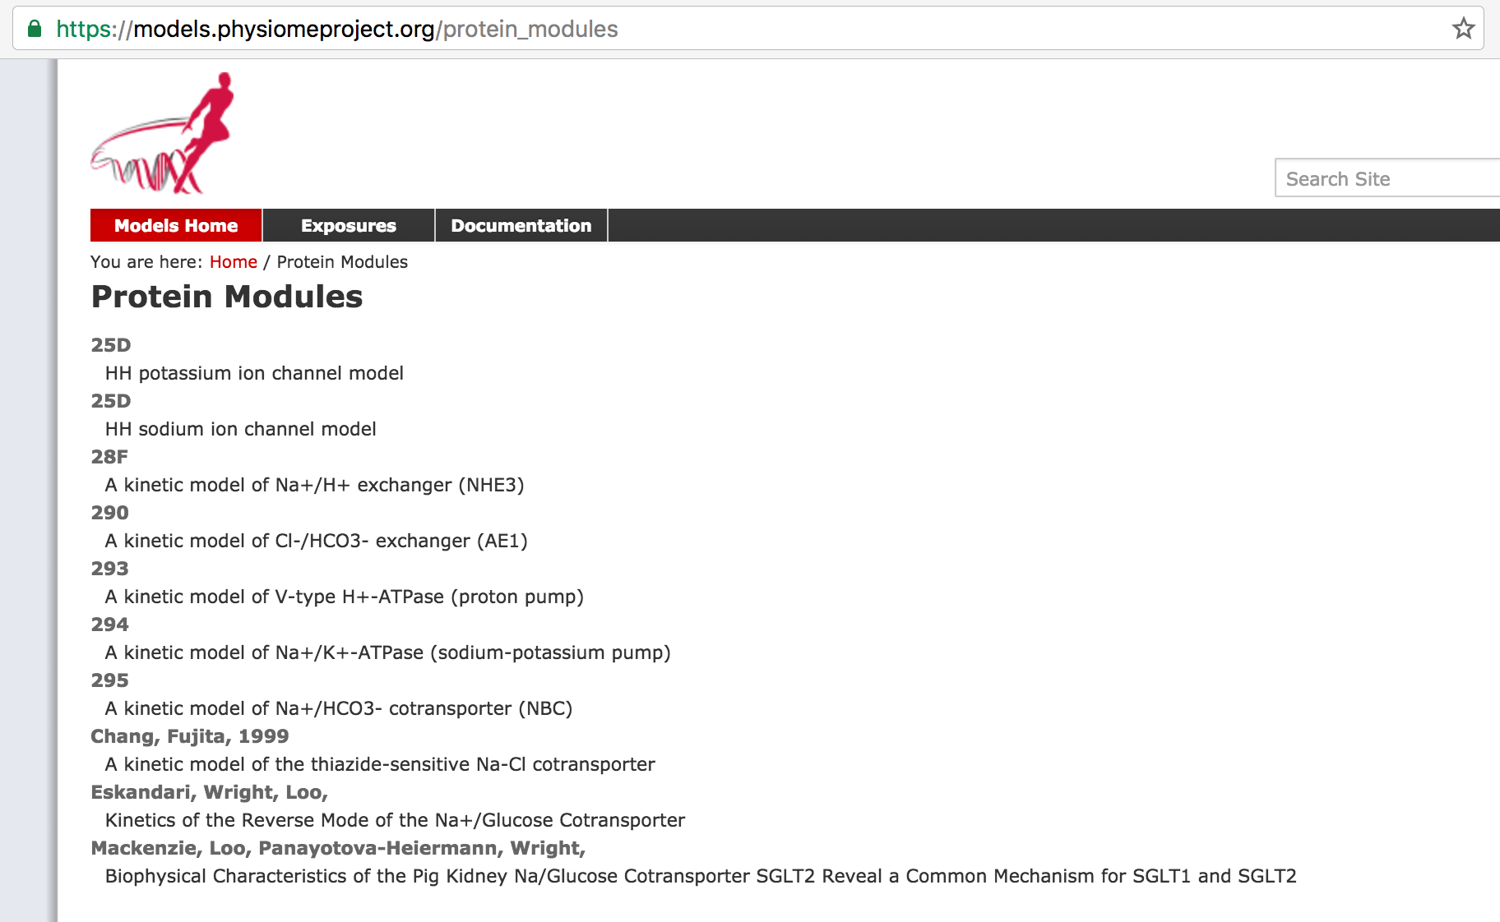
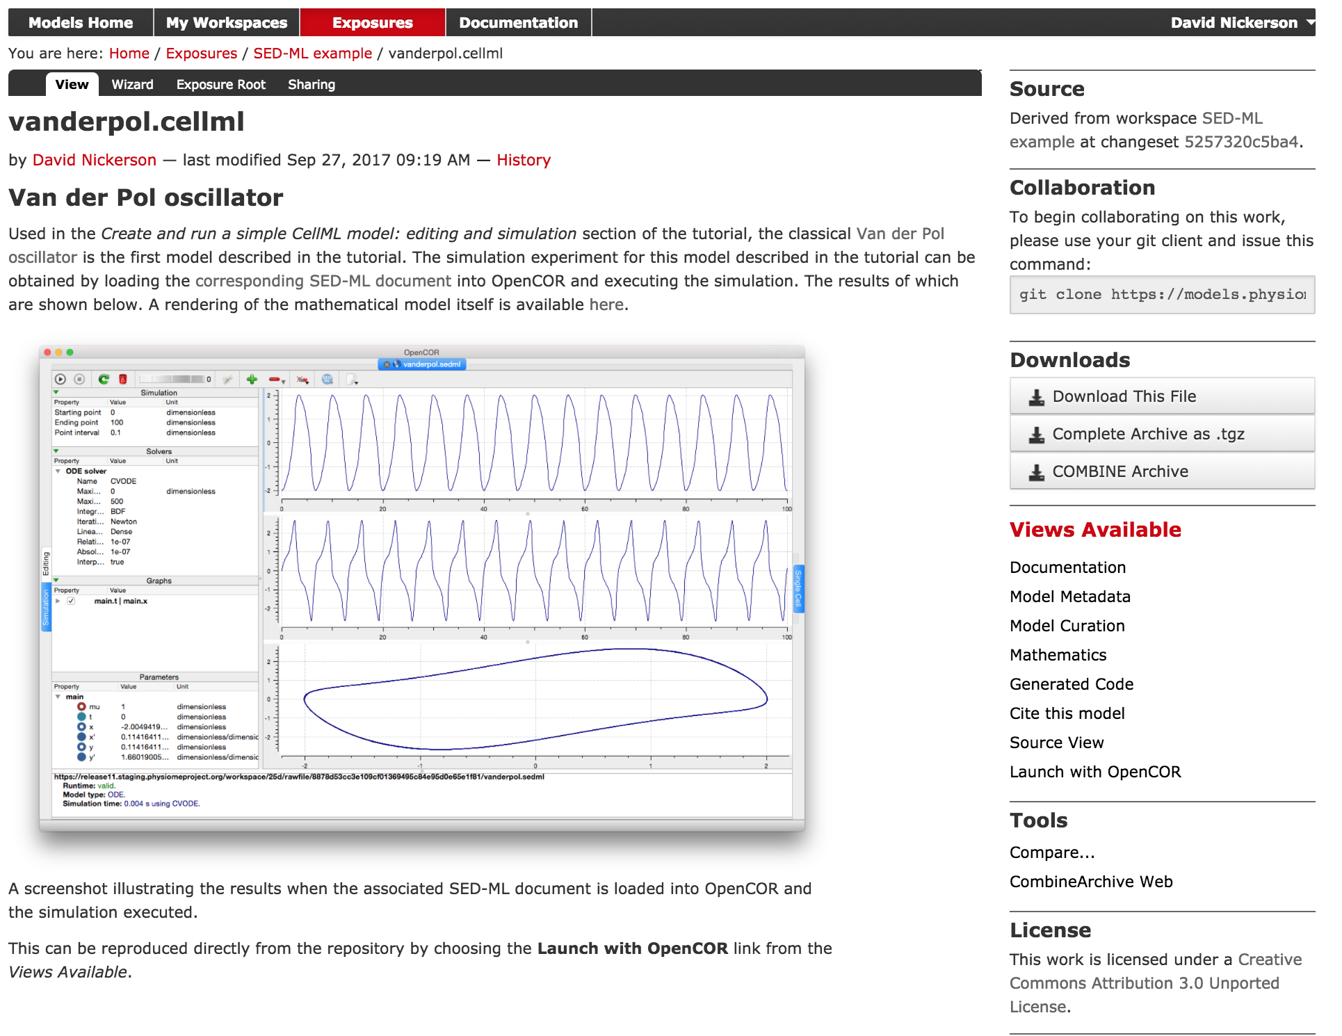
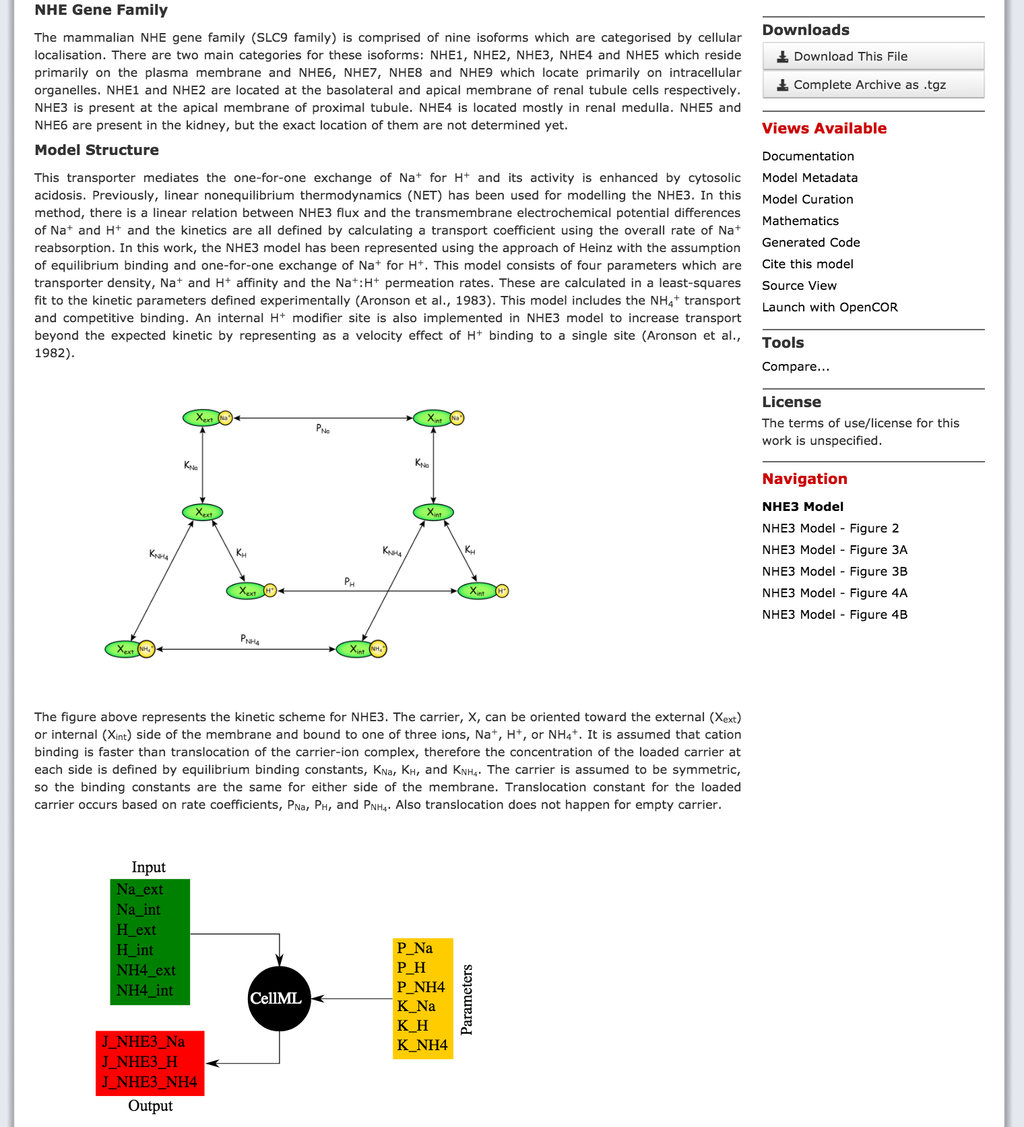
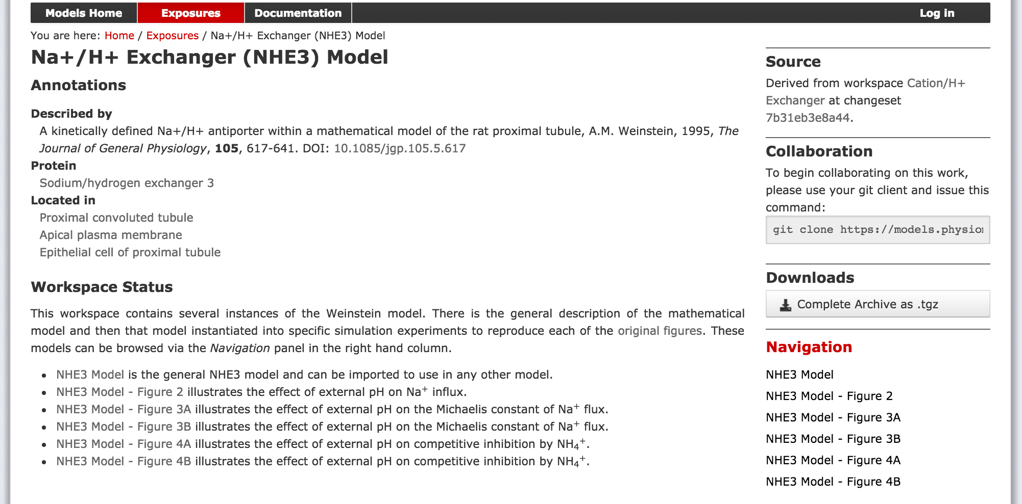
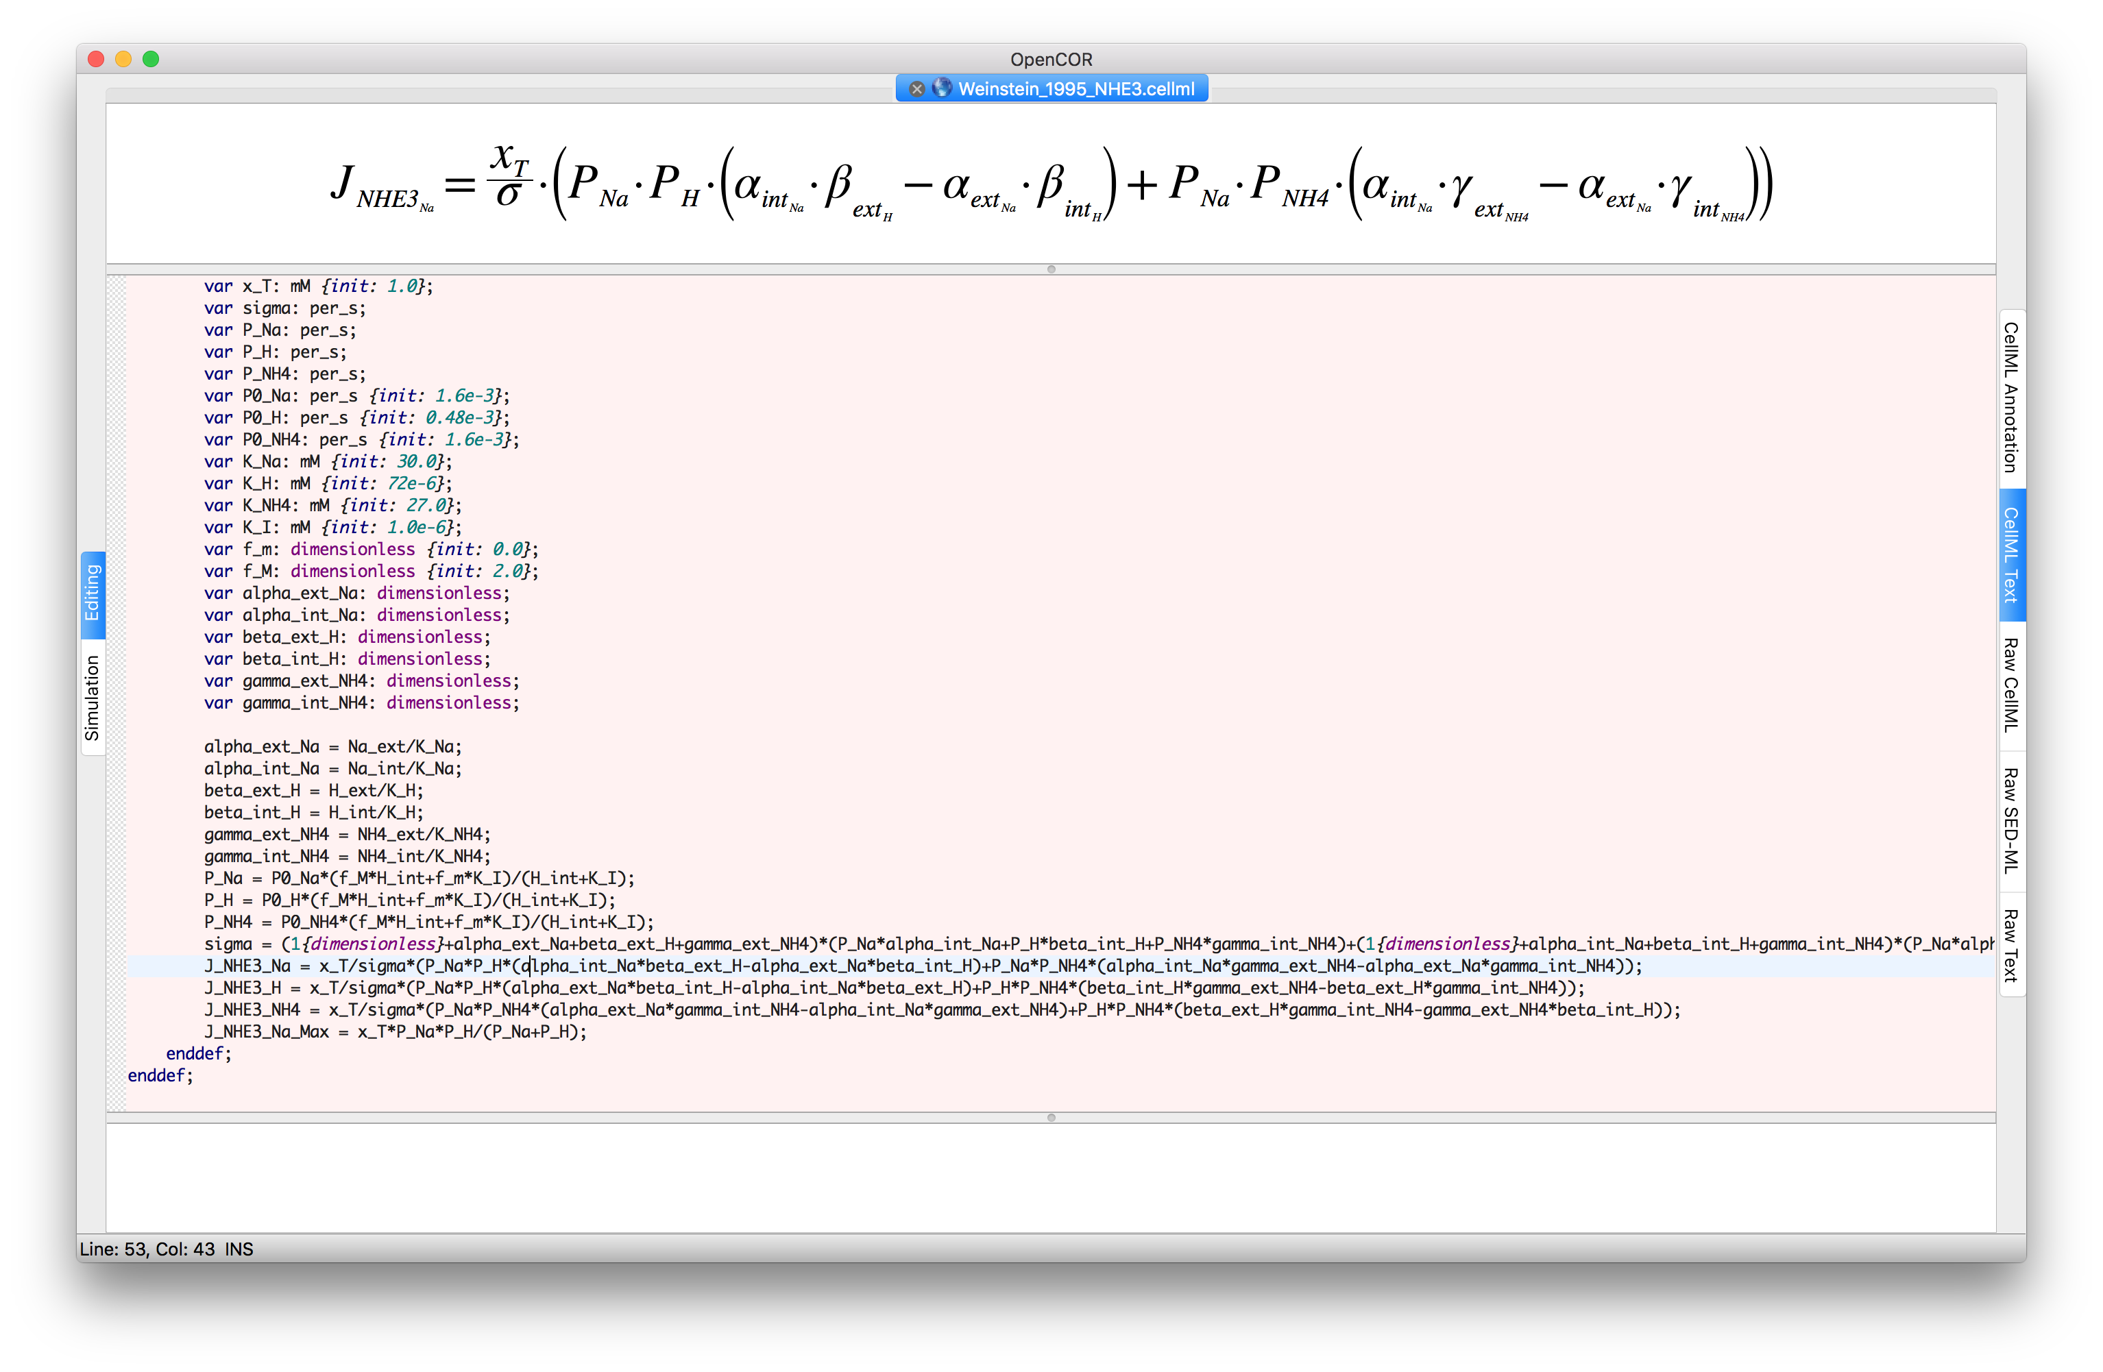
Key resources

Slide 6
OpenCOR
Key resources
Modelling environment for organising, editing, simulating and analysing CellML files on Windows, Linux and macOS.
Plugin-based application with both a command line (CLI) and a graphical user interface (GUI).
Full CellML support and partial SED-ML support.
Open source project (GPL v3.0 license).
(Very) simple website: opencor.ws.
On GitHub: github.com/opencor/opencor.
Prerequisites: Git, CMake, C++ toolchain and Qt. Optional: Ninja, clcache/ccache, NSIS (Windows) and PackageMaker (macOS).

Slide 7
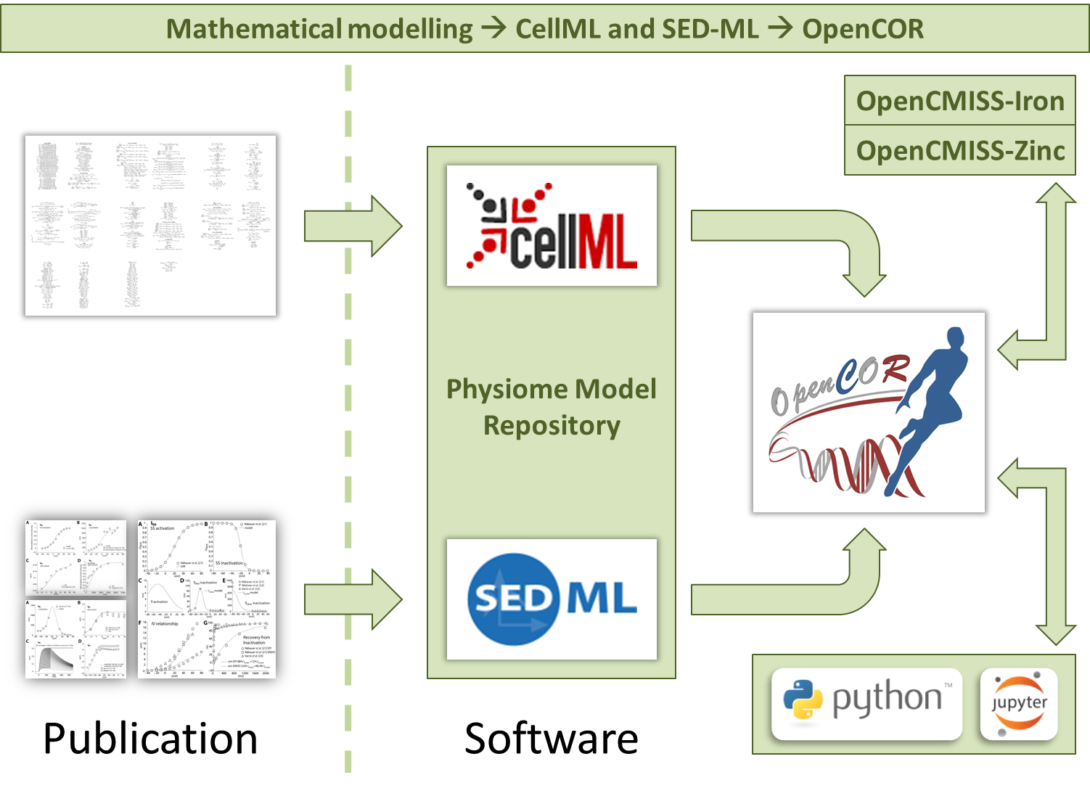

Slide 8
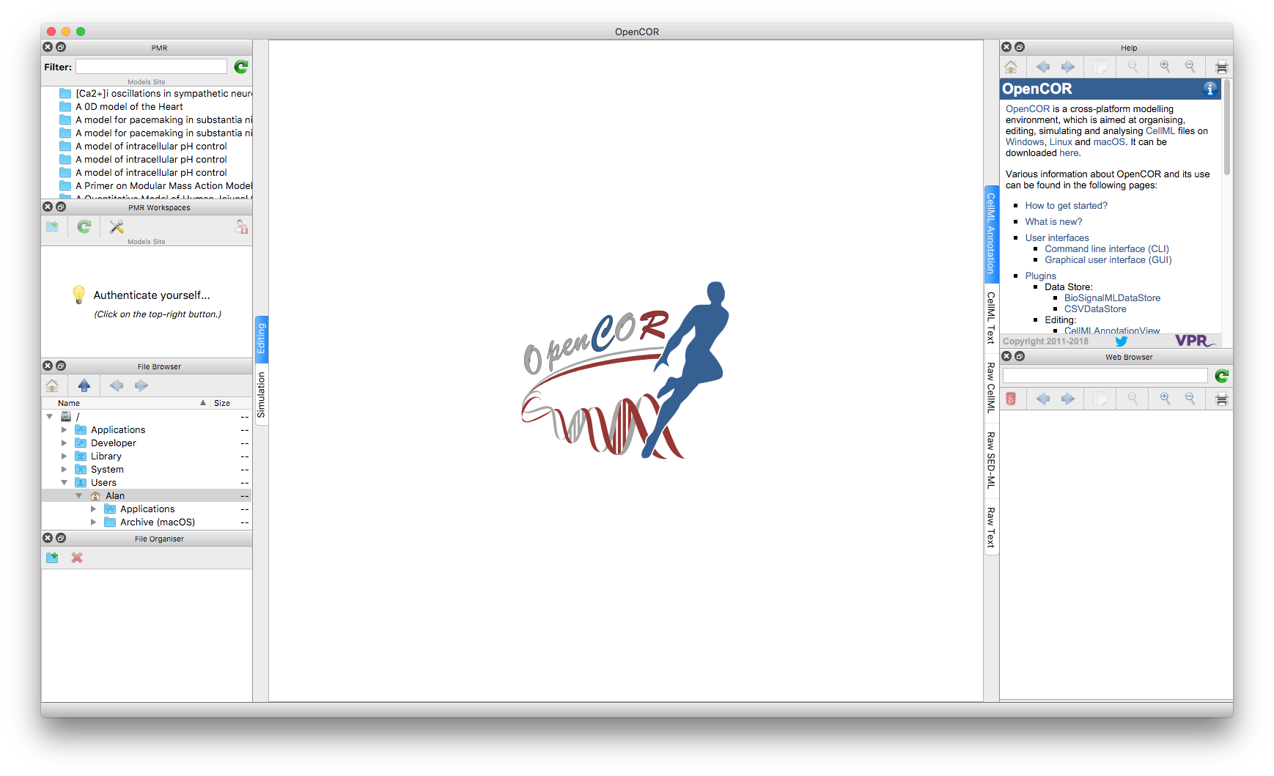
PMR window
PMR Workspaces window

Slide 9
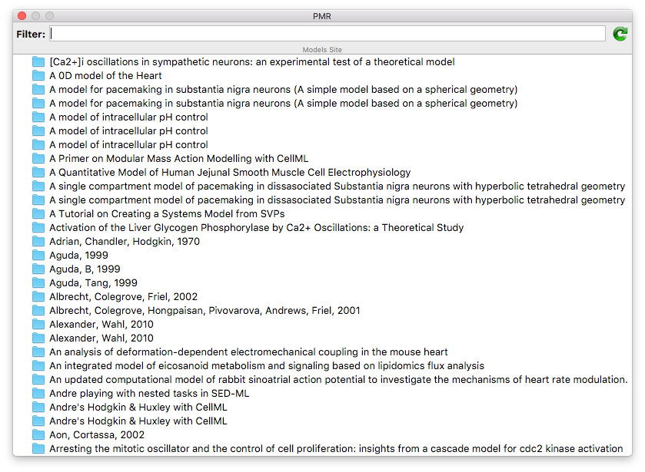
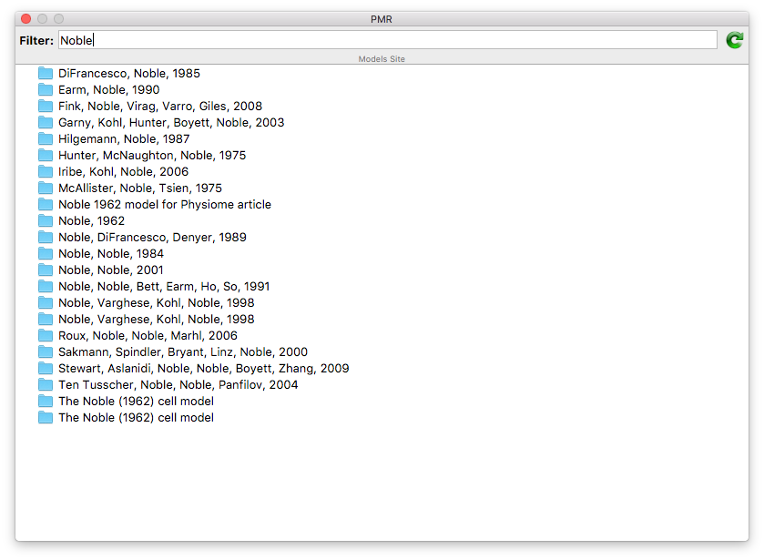
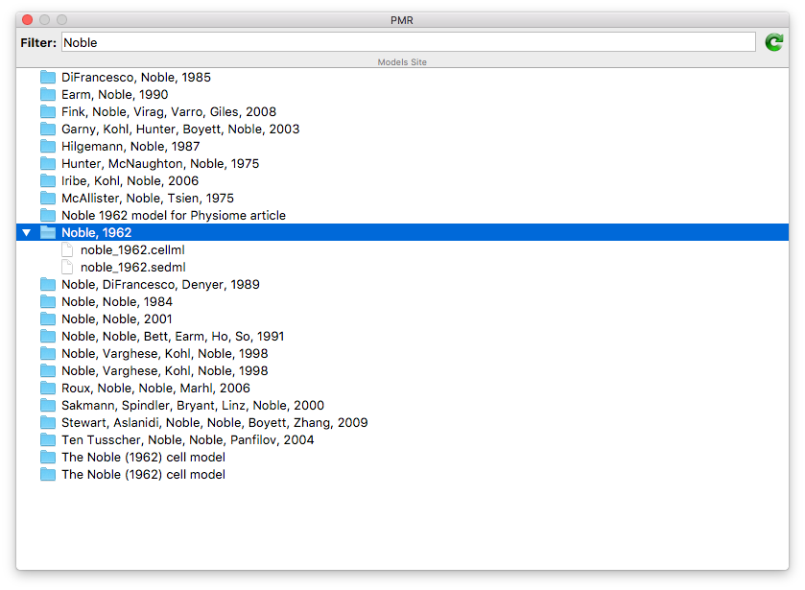

Slide 10
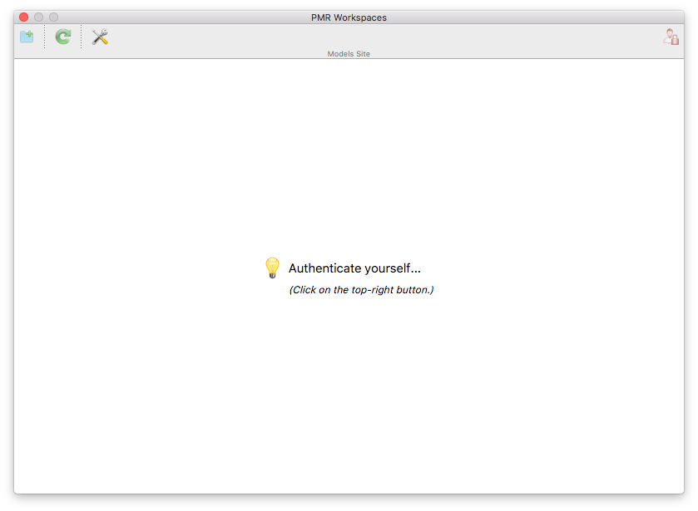
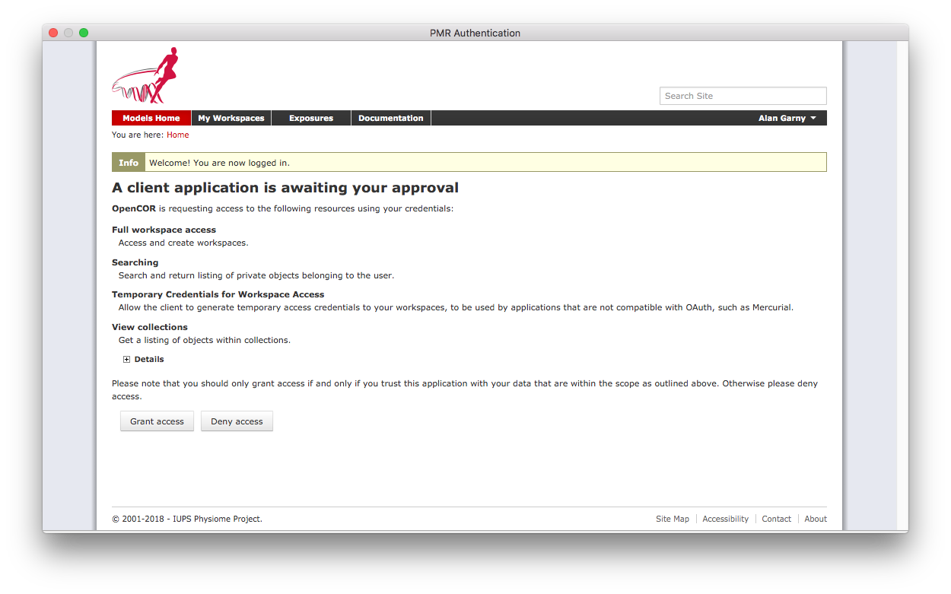
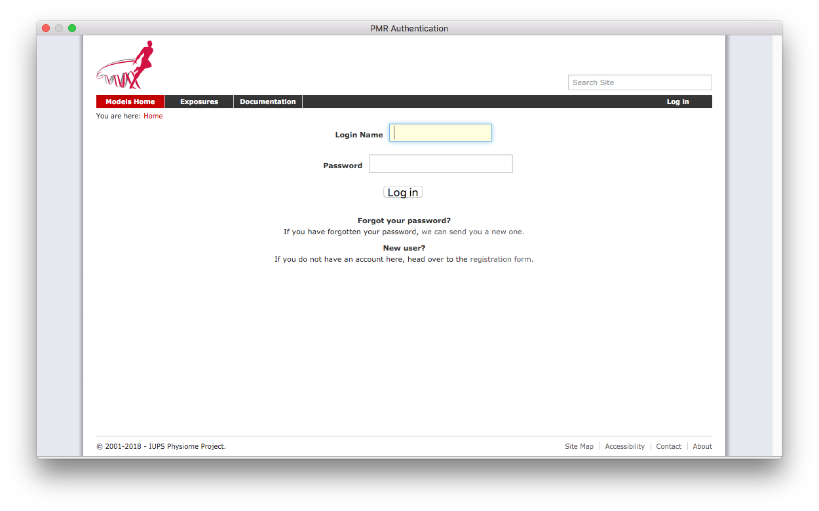
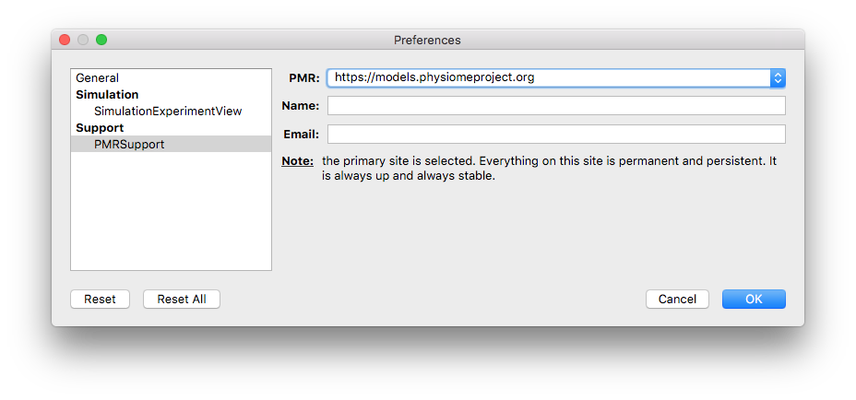
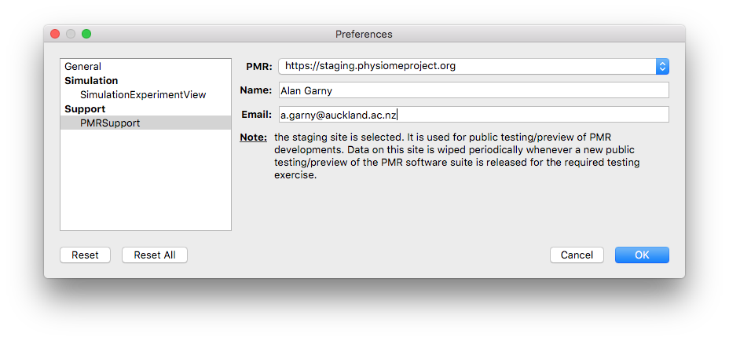

Slide 11
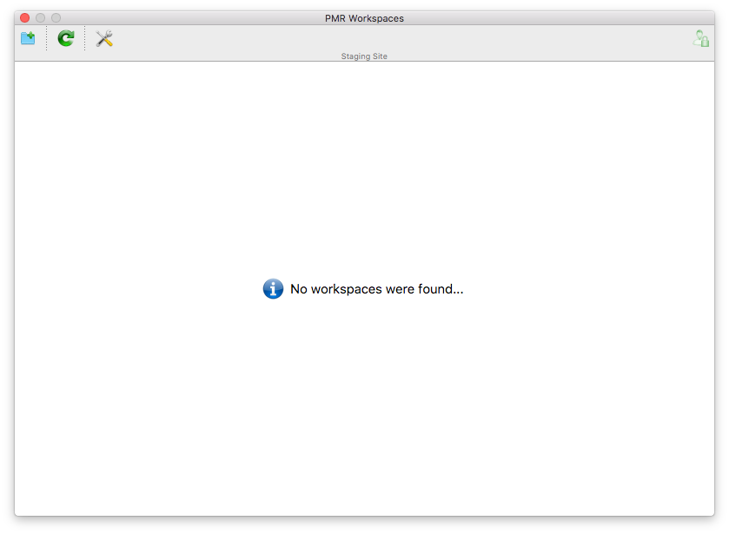

Slide 12

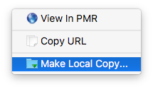

Slide 13
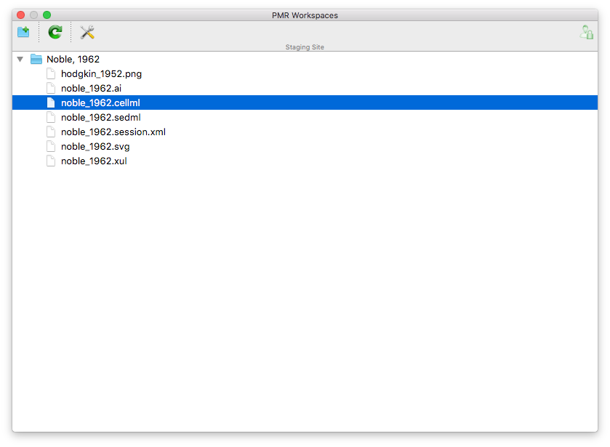
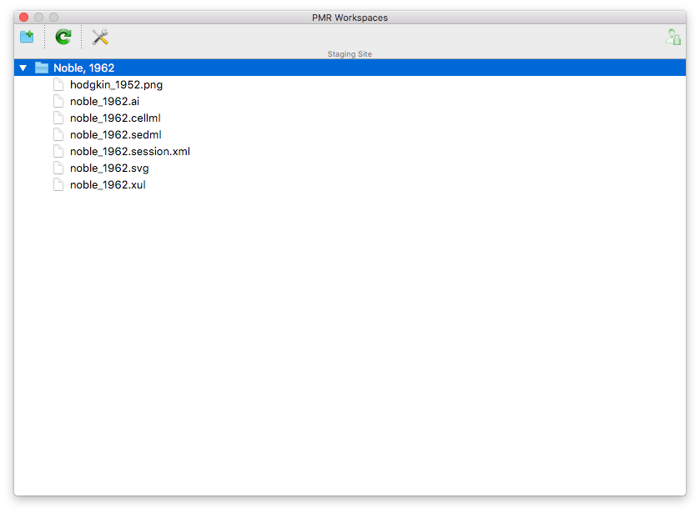

Slide 14






Annotation harmonization
Common approaches for annotation
Speak the “same” language
cross-repository discovery
cross-standard reuse and merging
common software tools
COMBINE archive?
Linking between models and health data
OPB:Chemical concentration property_of
CHEBI:potassium (1+) part_of
FMA:Portion of blood
AQL
SPARQL
Clinical data Repository
Clinical data annotations
(SNOMED CT, LOINC)
Manual Ontology Mapping
Model annotation
(composite annotation)
Model Repository

Slide 15
COMBINE goals
Annotation, annotation, annotation…
Wednesday late afternoon to get started
Friday early afternoon to wrap up
Encoding and Exchanging Medical Data in Standards
Thursday early afternoon
No specific breakout
data, experiment, workflow annotation
reproducibility centre (Ion’s talk Friday morning)
Physiome journal

